Slide 1
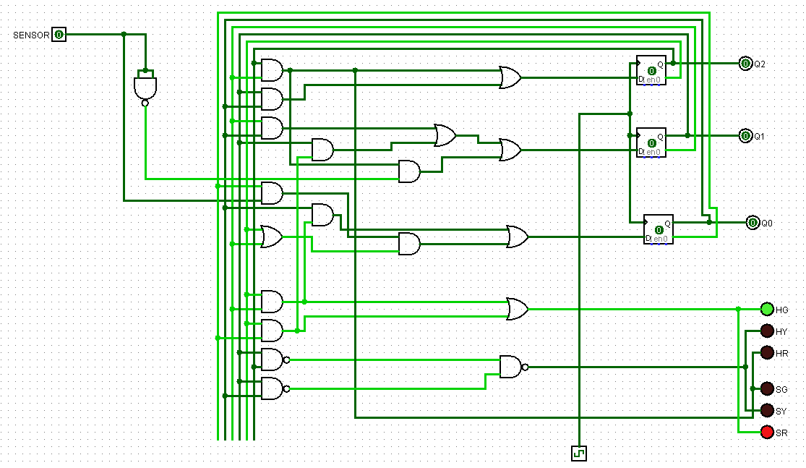
State 1
When there is no car on the side street so the sensor reads 0 and the highway light is green

Slide 2
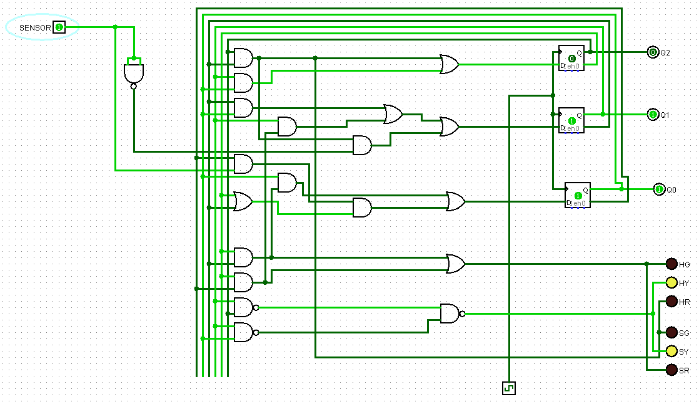
State 2
When there is a car on side street so there is transition in lights and when the lighs turn to yellow

Slide 3
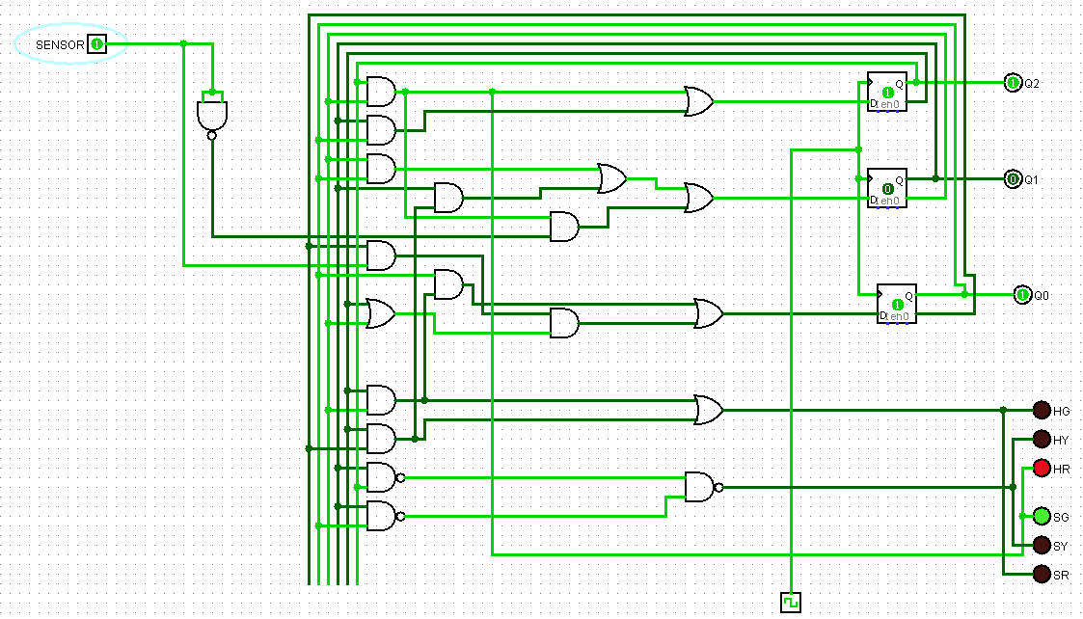
State 3
When the lights after transition turn to red on side street due to car present on that road

Slide 4
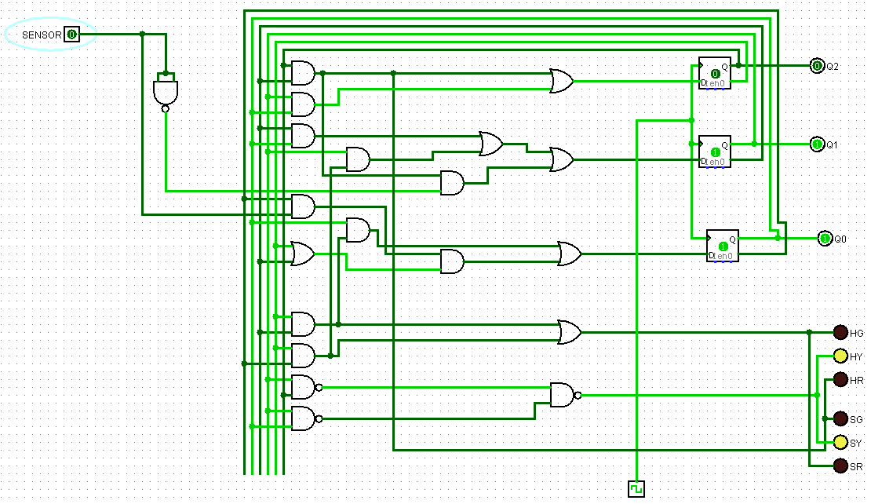
State 4
When the car isn’t there on side street so sensor goes to 0 and there is transition in lights again and when the lights are yellow

Slide 5
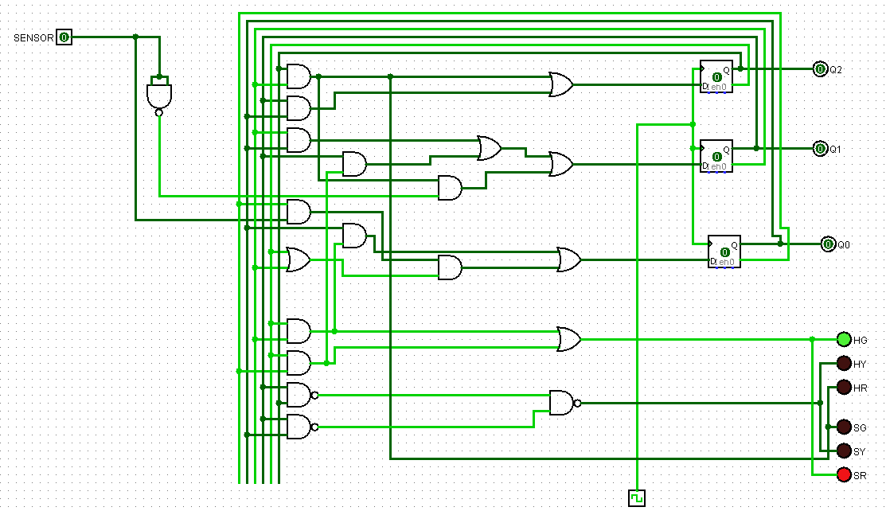
State 5
After transition when the lights again turn as usual (green on highway) so as to not impede traffic and the cars on highway can go easily.

